Slide 1
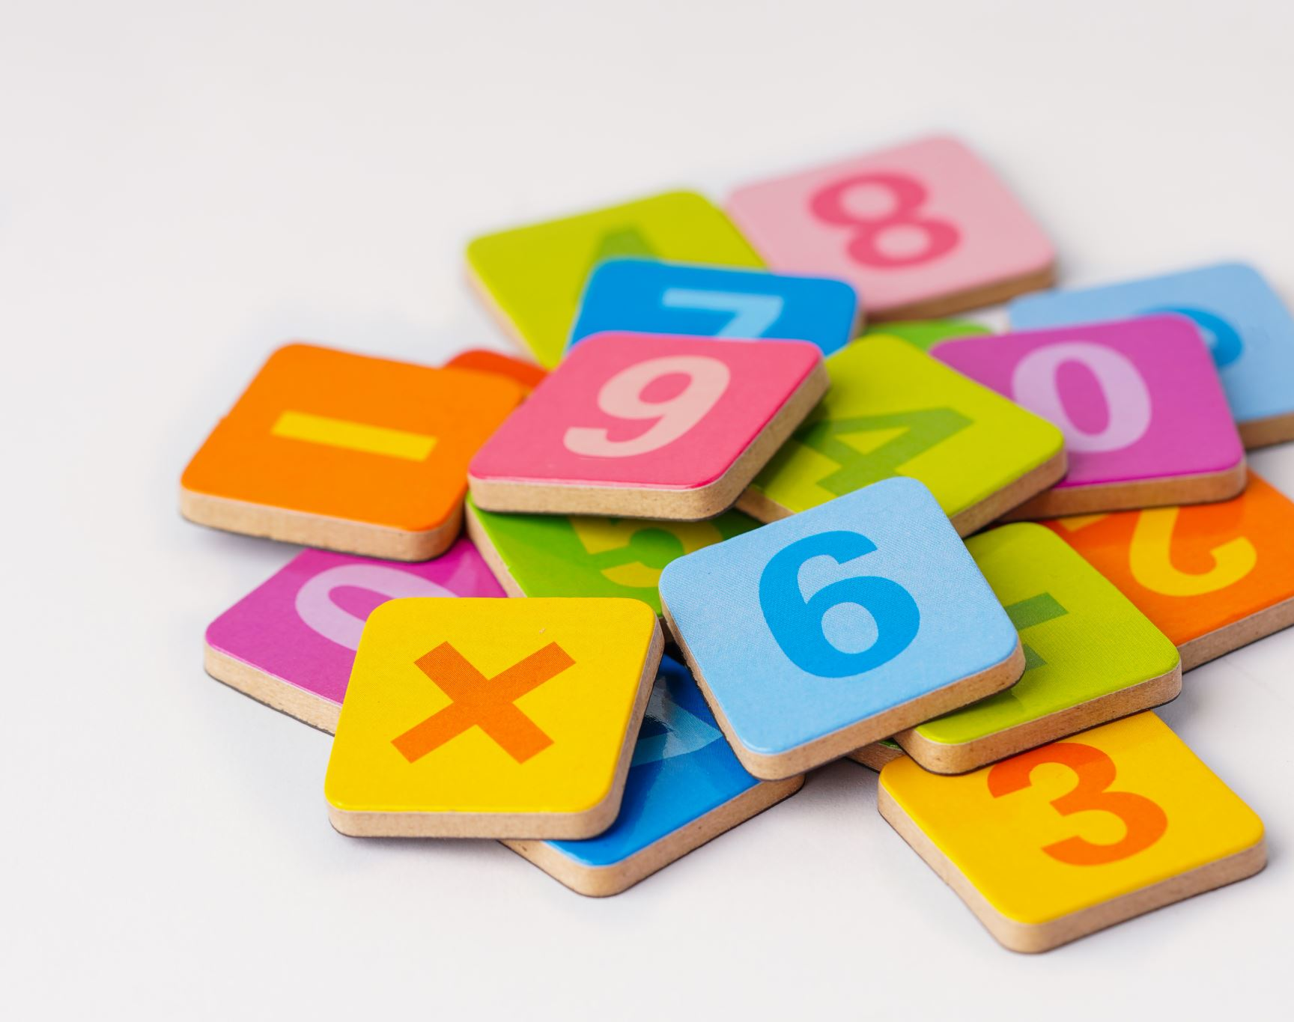
Math Club for Grades 4 and 5 @ Sunrise Library
School Year: 2023 - 2024

Slide 2
Math Club details
Class: Once in 2 weeks
Where: Sunrise Library
Time: 4 pm – 5:30 pm
Day of week: Thursday
Months: October ‘23 -> March ‘24
Students will participate: 2 competitions
Names of competitions: 1) Math Olympiad
2) Math is Cool
Cost: $40 per student (competition fees, study material, snacks, pizza on day of competition, etc)

Slide 3
Goals of Math Club
Build confidence to solve complex math problems
Working in teams
Learn techniques to solve problems
Build speed
Exposure to other kids at competitions
Nurture a lifelong love for math
Have fun
Improve public speaking skills

Slide 4
Math Olympiad
Five monthly contests (5 questions each) in Nov, Dec, Jan, Feb & March
Students work alone, scoring 1 point for each correct answer
Administered at Sunrise library
Five problems that must be completed in 30 mins
Contests may be administered at the time and date chosen by the PICO (person in charge of Olympiad) within a four-week window
PICO scores each contest and submits scores to MOEMS® using answer key provided
Each team may have up to 35 students

Slide 5
Math is Cool
Location: In person competition held at Liberty High school, Renton (~45 mins drive from Sunrise)
Grade 4 competition: March 23, 2024 (Saturday) : 9:30 am – 2 pm
Grade 5 competition: March 9, 2024 (Saturday) : 3:30 pm – 8 pm
2 individual sections, 3 team rounds (answers to be written on paper) & 1 buzzer round
Teams consist of 3-4 students
A school can have up to 8 teams (~32 students per Grade level)
4 hours (with a 1-hour break for lunch/dinner)
Lunch/Dinner will be provided (pizzas)
Registration deadline: 1 month prior to competition date

Slide 6
Class schedule for the year
Month | Grade 4 | Grade 5
October | 12, 26 | 19
November | 9, 16 | 2,30
December | 6 | 13
January | 4, 18 | 11,25
February | 1,15 | 8,29
March | 7,21, 23,28 | 9, 14
Legend:
Red – Math Olympiad monthly test (Regular class will be help for the remaining one hour)
Blue – Math is Cool competition dates
Black – Regular classes

Slide 7
What we will do in class
Review math concepts (area, volume, percentages, time, probability, etc)
Solve questions from prior years competitions
Have students present their answers to class (Improve public speaking skills, learn to accept feedback)
Buzzer round (Speed - Answer math questions in a few seconds)

Slide 8
Student/Parent Expectations
Students to complete assigned homework every week
Students need to spend 3 hours per week to master concepts
Students to let instructor know if they have difficulty in solving homework problems

Slide 9
Help Needed/Expectations
Middle/High school students to help students during class (Volunteer hours for Honor Society)
Substitute parent to conduct class when main instructor is on vacation/out of town

Slide 10
Instructors
Instructor: Boris Gonsalves(Parent of Lizanne Gonsalves – Grade 4) (borisgonsalves@gmail.com)
Assistant Instructor: Karishma Singh-Chowdhry (Parent of Alisha Chowdhry – Grade 5)
Additional volunteers: TBD

Slide 11
Reference material
Math Olympiad sample problems: Link
Math Olympiad website: Link
Math is Cool Grade 4 sample paper: Link
Math is Cool competition day schedule (click on 1st row- Liberty high school and the desired grade level): Link
Math is Cool Grade 5 sample paper: Link
Math is Cool website: Link
Math is Cool previous year’s tests: Link

Slide 12
Questions? Panel of three students from last year’s Math Club

